Slide 1
Where to Go Next: Modeling Long- and Short-Term User Preferences for Point-of-Interest Recommendation
AAAI-2020
汇报人：高钰澜 2021年1月24日

Slide 2
Catalogue
1
Background
2
Model
3
Experiments
4
Conclusion

Slide 3
Background

Slide 4
Background
Point-of-Interest (POI) recommendation has been a trending research topic as it generates personalized suggestions on facilities for users from a large number of candidate venues.
Motivate
RNN-based methods
· neglect users’ long-term preferences
· overlook the geographical relations among recently visited POIs
Long- and Short-Term Preference Modeling (LSTPM)

Slide 5
Model

Slide 6
a set of users
a set of POIs
where each POI is geocoded by a (longitude, latitude) tuple, i.e., (lon_{l}, lat_{l})
user's historical trajectory
each historical trajectory
current trajectory

Slide 7
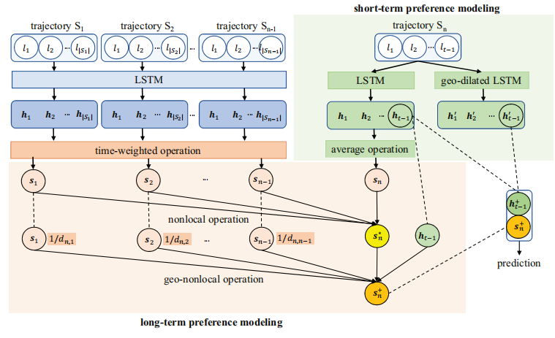
Model

Slide 8
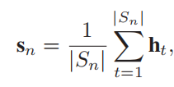
Long-Term Preference Modeling

Slide 9
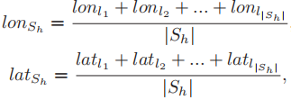
Long-Term Preference Modeling

Slide 10
Short-Term Preference Modeling

Slide 11
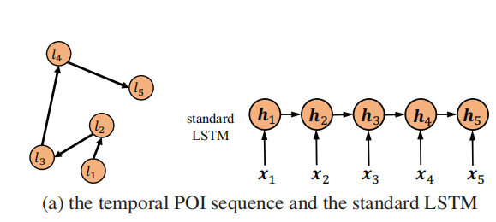
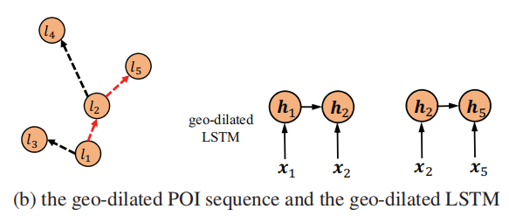

Slide 12
Prediction

Slide 13
Experiments

Slide 14
Dataset
Foursquare and Gowalla

Slide 15
Experiments
Analysis on Recommendation Effectiveness

Slide 16
Analysis on Key Components in LSTPM
• LSTPM-L: This version removes the short-term component of LSTPM and only engages the long-term one.
• LSTPM-S: This version removes the long-term component of LSTPM and only engages the short-term one.

Slide 17
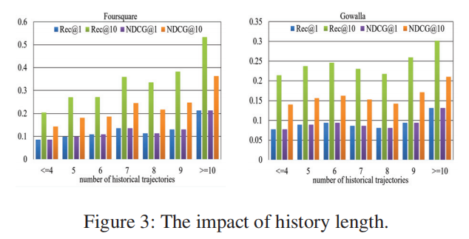
Analysis on Impact of History Length

Slide 18
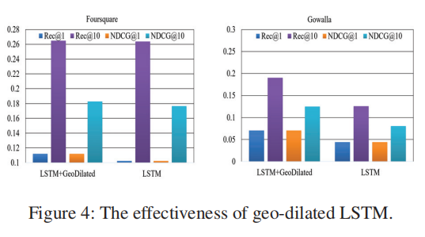
Analysis on Effectiveness of Geo-Dilated LSTM

Slide 19
Conclusion
· we develop a context-aware non-local network to model long-term preferences and a geo-dilated LSTM to model short-term preferences.
·The experimental results demonstrate that our proposed approach substantially improves the recommendation accuracy compared with the state-of-the-art methods.

Slide 20
Thank you for watching

